Slide 1
ACCOUNTING CYCLE
Transactions (source documents)
Books of first entry
General ledger
Trial balance
Adjustments
Financial statements

Slide 2

ACCOUNTING CYCLE
An entity is any business that conducts operations and is involved in trading. It can sell goods or render services with or without the objective of making a profit.
There are various types of entities:
Sole proprietorships
Partnerships
Closed corporations
Companies
Theory, page 2
https://www.golegal.co.za/s164-companies-shareholders/

Slide 3
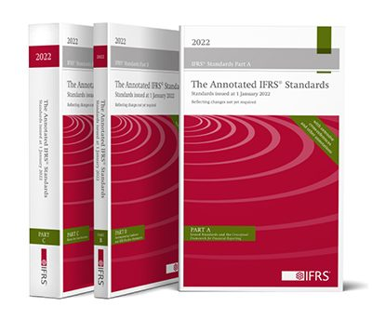
ACCOUNTING CYCLE
Transactions (source documents)
Books of first entry
General ledger
Trial balance
Adjustments
Financial statements
The accounting cycle
Recording and processing
Correcting mistakes
Compliance with accounting principles
Preparation of financial statements
Theory, page 2
https://www.ifrs.org/

Slide 4
ACCOUNTING CYCLE
Recording and processing
Double entry system
Dt vs Cr
E + L = A
OR
E = A - L
Theory, page 2

Slide 5
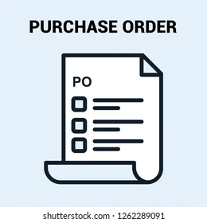



ACCOUNTING CYCLE
Processing and recording transactions:
Source documents Internal
External
Journals
Purchases journal Sales journal
Purchases return journal Sales return journal
Cash payments journal Cash receipts journal
General journal
General ledger
Transactions (source documents)
Books of first entry
General ledger
Trial balance
Adjustments
Financial statements
Theory, page 3

Slide 6
ACCOUNTING CYCLE
Accounting systems:
Objective
Processing of similar transactions
Information for decision-making and reporting
Requirements
Relevant, accurate and timely information
Internal controls
Adaptable
Design
Transactions (source documents)
Books of first entry
General ledger
Trial balance
Adjustments
Financial statements
Theory, page 4

Slide 7
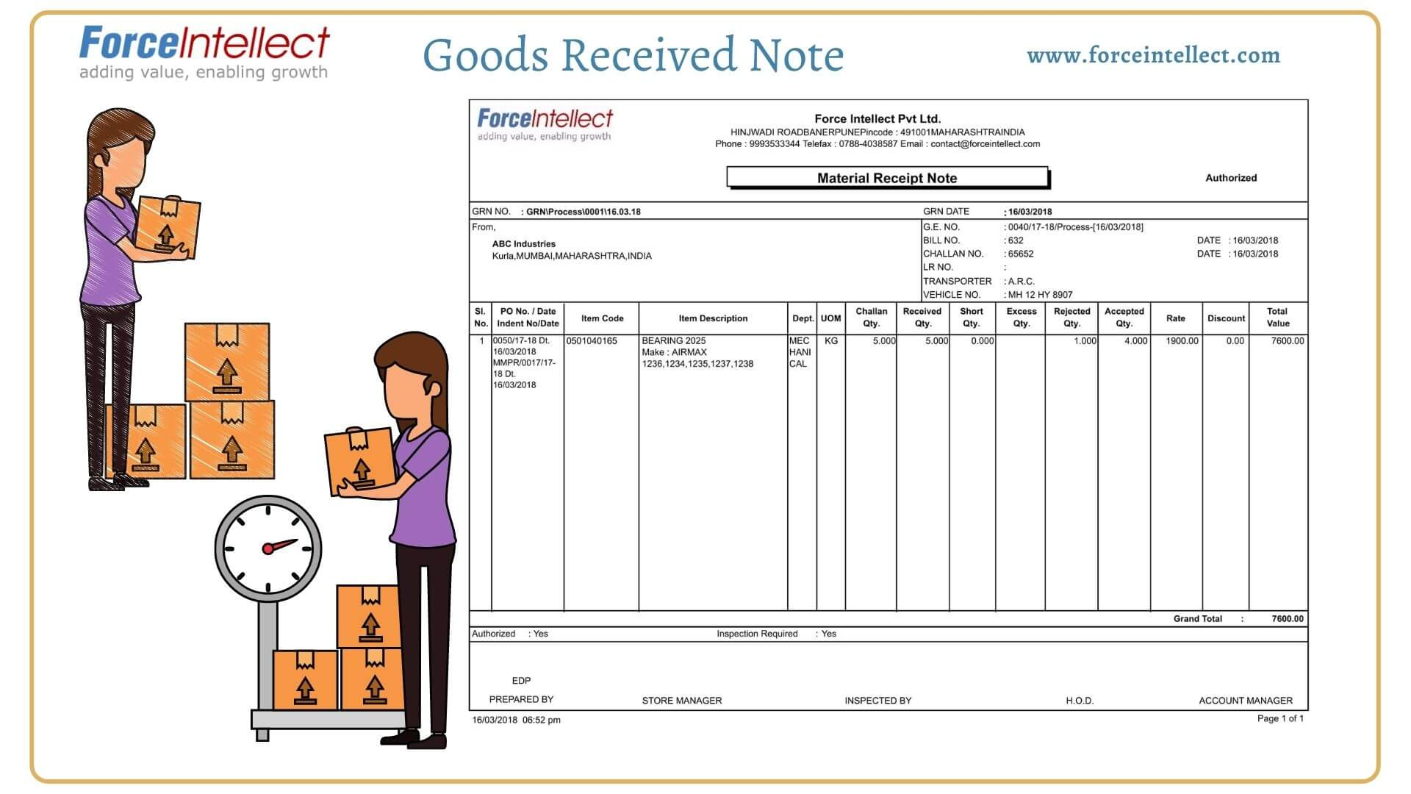
PURCHASES AND CREDITORS
Objective:
All purchases must be authorised
Controls ensuring that ordered goods are actually received
The invoiced prices should agree to the price agreed upon
All obligations must be recorded accurately
Creditors must be paid on time
Source documents:
Requisitions Order form
Goods received note Invoice
Monthly creditors’ statement Proof of payment
Payment requisitions Bank statements
Theory, page 4-6
Example 1

Slide 8

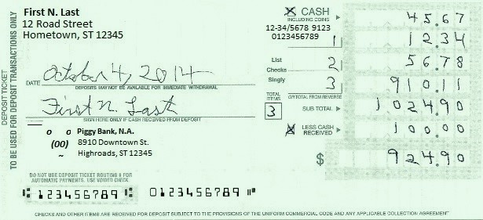
SALES AND DEBTORS
Objective of the system
All sales must be recorded timeously
The correct amount must be invoiced
All payments must be recorded
There must be control over the collection of monies
Source documents
Delivery note Invoice
Monthly debtors’ statement Receipt
Bank deposit slip Bank statement
Theory, page 6-8
Example 2

Slide 9
SALES AND DEBTORS
Returns
Debtors
Age analysis
Monthly statements
Bad debts
Follow certain procedures before deeming a debt irrecoverable
Specific debtors are written off
Dr Bad debts (P/L)
Cr Debtors (SFP)
Decrease in the debtors’ control account in the general ledger, as well as in the debtors’ ledger
Remember:
In a general journal entry, you must indicate where in the financial statements you will find the account
Theory, page 8-10
Example 3

Slide 10
SALES AND DEBTORS
Recovery of bad debts
TWO SCENARIO’s
Debt written off during the year and later recovered in the same year
Only the irrecoverable portion of the debt may be recorded as an expense during the year.
Dr Bank (SFP)
Cr Bad debt (P/L)
(Expense decreases by the amount recovered)
Debt written off in the previous year and recovered in the current year
Accounting records of the previous accounting period have already been finalised.
Dr Bank (SFP)
Cr Bad debts recovered (P/L)
Remember:
debit bank, and then credit:
If same debtor, same year: decrease bad debts expense OR
If recovered in a different year: increase bad debts recovered
Theory, page 9-10
Example 3

Slide 11
ALLOWANCE FOR CREDIT LOSSES
General allowance, not for specific debtors (therefore no entries to the debtors’ ledger or debtors’ control account)
Debtors are presented net of the allowance for credit losses of debtors in the Statement of financial position.
Journal:
Increase in the allowance:
Dr Movement in allowance for credit losses of debtors (P/L)
Cr Allowance for credit losses of debtors (SFP)
Decrease in the allowance:
Dr Allowance for credit losses of debtors (SFP)
Cr Movement in allowance for credit losses of debtors (P/L)
Tip:
Draw the GL account (T-account) to help.
The SFP account can be debited or credited, but the balance must always be a credit
Theory, page 10-11
Example 4

Slide 12
PREPARATION OF FINANCIAL STATEMENTS
Accounting period
Closing of ledger accounts
Sales and cost of sales:
» Trade account
Income and expense accounts, and Trade account:
» Profit or loss account
Profit or loss account:
» Retained earnings
= P/L
= Equity
Theory, page 12-14
Example 5

Slide 13
PREPARATION OF FINANCIAL STATEMENTS
Accounting period
Closing of ledger accounts
Owners’ equity = Assets - Liabilities
Trial balance
Errors which result in the trial balance not balancing
Errors in a trial balance which balances
Determining profit
Trading entity : Sales – Cost of sales
Service entity: Income less expenses
Transactions (source documents)
Books of first entry
General ledger
Trial balance
Adjustments
Financial statements
Theory, page 12-14
Example 5

Slide 14
ADJUSTMENTS
Accrual basis
The effect of all transactions and events should be recorded in the period in which those effects occur,
even if the resulting cash receipts and payments occur in a different period.
Example:
Sell inventory with a selling price of R125 to a debtor:
Dr Debtors (SFP) 125
Cr Sales (P/L) 125
We record the sale (effect of transaction) even if we have not yet received the money.
P.S. What is matching principle if this is accrual principle?
Theory, page 14-15
Example 6

Slide 15
RECONCILIATIONS
Detection of errors
Control accounts and subsidiary ledgers
The debtors’ control account should agree to the debtors’ ledger
The creditors’ control account should agree to the creditors’ ledger
Two sources are available to detect errors
Internal sources: trial balance, comparison between control accounts and subsidiary ledgers
External sources: Bank statements, monthly creditors’ statements
Theory, page 15

Slide 16
RECONCILIATIONS
Bank
Compare the closing balance per the bank statement to the closing balance per the bank account.
Steps:
Check whether the previous month’s corrections were done.
Inspect the bank statement for errors – e.g. deposits not for out entity, incorrect casting.
Compare the individual entries on the bank statement to the entries to the bank account and journal, and vice versa.
Theory, page 16-17
Example 7

Slide 17
RECONCILIATIONS
Debtors
Reconcile the debtors’ control account and the debtors’ ledger
Steps:
Check the casting of the debtors’ ledger, the debtors’ list and the debtors’ control account.
Inspect the debtors’ ledger and debtors’ control account and confirm that the listed items are appropriate and have been cast or subtracted correctly.
Inspect the books of first entry (journals) transferred to the debtors’ control account and debtors’ ledger.
Theory, page 18

Slide 18
RECONCILIATIONS
Creditors
Reconcile the creditors’ ledger of a specific creditor to the monthly creditor’s statement
Steps:
Check the casting of the creditors’ ledger, as well as the monthly creditor’s statement.
Inspect the creditors’ ledger and the monthly creditor’s statement and confirm the items listed are appropriated and have been cast or subtracted correctly.
Compare the individual entries between the monthly creditor’s statement and creditors’ ledger.
Theory, page 18
Example 8

Slide 19
ACCOUNTING CYCLE: - where does FinAcc fit in?
Transactions (source documents)
Books of first entry
General ledger
Trial balance
Adjustments
Financial statements
Transactions
Trial balance + adjustments (general journal)
AFS
Summarise transactions: journals (books of 1st entry)
Summarise journals: general ledger
Understand this (but computer can also do it)
High-level adjustments, critical thinking to make decisions

